Slide 1
Final project group
Group 8

Slide 2
Learning English and international faculty
Name: Hanan Al Jarash
Name: Faie Almofeez
Name: Fahad Al Qahtani
Name: Aws Zahrani

Slide 3
Overview of the Project
Initial Thoughts, Beliefs, and Research.
Interview Results.
Reflective Summaries.
Conclusion.

Slide 4
Initial Thoughts, Beliefs and Research
Student Responses

Slide 5
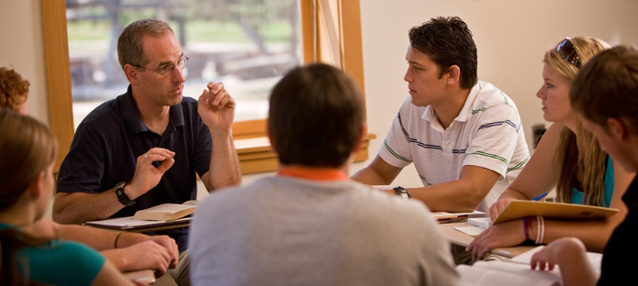
Hanan Al Jarash: Initial Thoughts, Beliefs, and Research
Social Issues
Language Issues
Research Results

Slide 6
Faie Almofeez: Initial Thoughts, Beliefs, and Research
Faculty issues
Adapt the culture
Workshops
Notes:
Before this project, I knew that some of the international faculty had some issues like culture shock. They find it really hard to adapt the new culture and the new language. After doing the research, I learned more about how the international faculty suffer from stereotype that people have. They are also frustrating because of the difference in academic culture and the new approach of teaching here in the U.S. I also learned that having workshops for the international faculty before they start teaching will be a good idea to solve this problem.

Slide 7
Fahad al Qahtani: Initial Thoughts, Beliefs, and Research
Language Issues
Adapt the culture

Slide 8
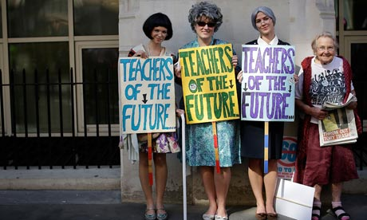
Aws zahrani: Initial Thoughts, Beliefs, and Research
International students had problems.
People need to
be taken care of.
Notes:
In this project I thought that only international students had problems of how to overcome learning English and how to become socialized in this new community they live in. I also noticed that they face challenges because they can not use their first language anymore. But I also discovered that even international faculty face problems, they can not find jobs easily that might be because of the lack of understanding of the American culture and the limitation of English fluency. Also some international people lose their first language due to not practicing it anymore. Some international people use both languages, their first language and English language and that is really good so they do not lose their own language.

Slide 9
Oral History/Interview
Victoria

Slide 10
Interview: Sample Questions
Our interviewee name is Victoria
Our Topics Of interest are:
Obstacles she faced.
Cultures differences
piece of advice
What was the most difficult thing for you when you were learning English?
People used to make fun of her accent.
What kind of things were different from your culture?
The way people here in America great each other.

Slide 11
Interview: What We Learned
what was learned :
Not all international faulty are suffering.
Similarity in languages can help to learn faster.
What will you do differently the next time :
Focus on specific questions.
Watch for the time limit.

Slide 12
Project Conclusion
Summary Reflections and Closing Comments!

Slide 13
Hanan Aljarash: Summary Reflection
Diversity in GMU
Research results

Slide 14
Faie Almofeez: Summary Reflection
Discrimination
Faculty at GMU
Notes:
Going deep in this topic, I learned that some of the International teachers are suffering from the discrimination. and to solve this issue they should adapt the American culture. American people also have to give the international faculty the same right as any other professor. On thing that surprised me was that here at George Mason, international teacher does not feel the same way/ and I was so grateful to know that.

Slide 15
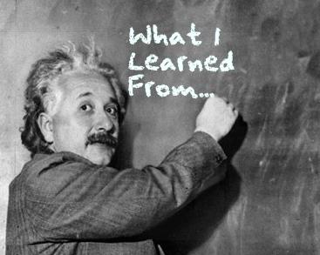
Fahad al Qahtani: Summary Reflection
What I learned.
English background.

Slide 16
Aws zahrani: Summary Reflection
What I learned.
English background.
Notes:
In this project I have learned about how international people face challenges while studying English in the United States of America and how they go through it and become successful people.
People who have a weak background in English they have a higher chance of overcoming those challenges. The internationalization program might give more chances for international students and faculty to learn and understand the American culture. And one thing that surprised me was that America need international people in their country for the economy.

Slide 17
Closing Comments
International faulty should have a special care to help them face their challenges.
Faie Almofeez
Hanan Aljarash
Fahad Alqahtani
Aws Zahrani

